Slide 1


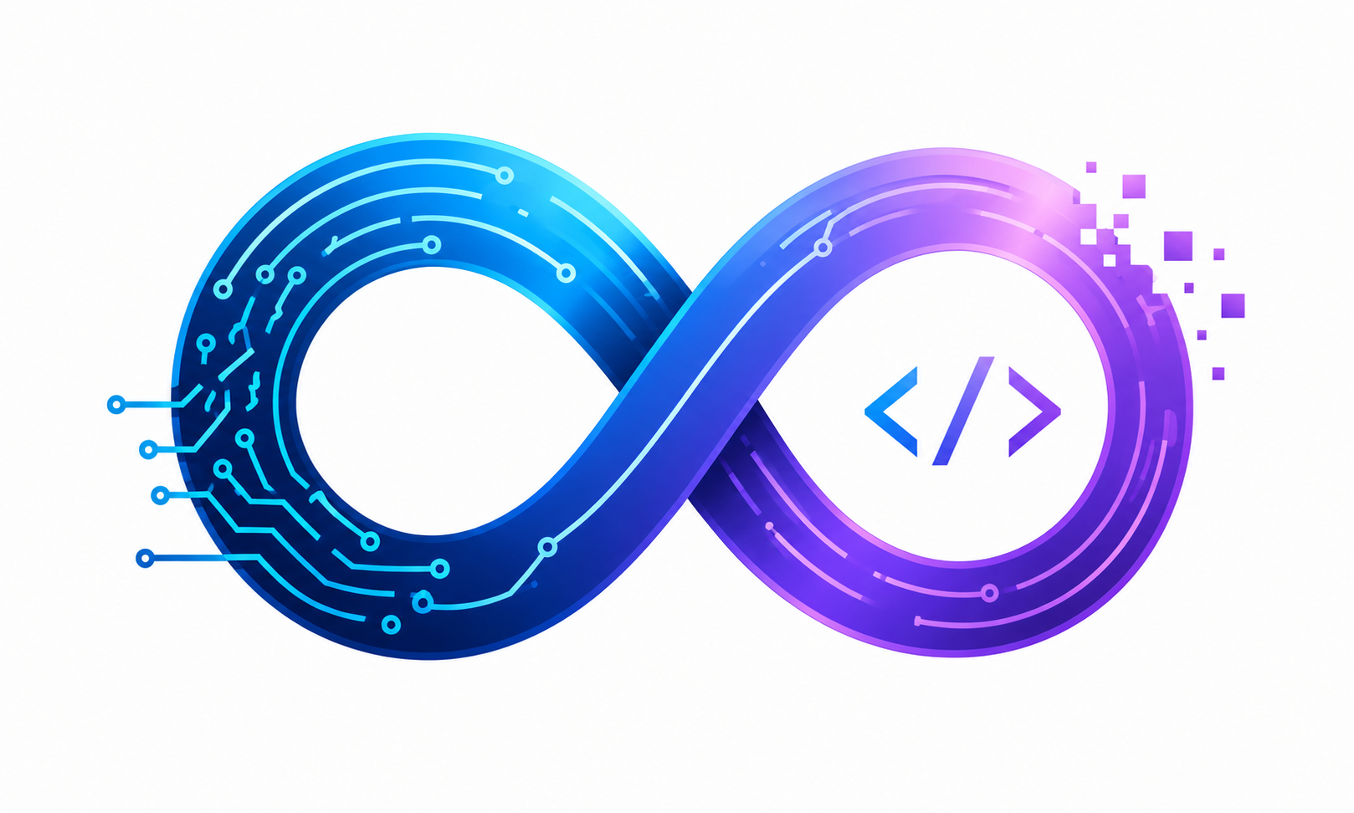
Zoo Management System
Enterprise Zoo Management Solution Built using C# (.NET 10) and Clean Architecture
Team Infinity Loop
Department
Md. Ibrahim Khalil Tushar • Noor Hasnat • Limon
Computer Science & Engineering
SOFTWARE ENGINEERING PROJECT
UNIVERSITY PRESENTATION

Slide 2
Problem Statement & Objectives
Problems Identified
Project Objectives
Manual animal records — error-prone and time-consuming
Manual feeding schedules — inconsistent dietary management
Poor enclosure management — capacity and habitat issues
Difficult visitor tracking — no centralized attendance data
Revenue calculation problems — inaccurate financial reporting
Manage animals digitally with full records
Manage keepers and staff assignments
Manage enclosures and habitat capacity
Calculate food requirements automatically
Track visitors and attendance analytics
Generate operational and financial reports
Improve overall zoo management efficiency

Slide 3
System Architecture
Clean Architecture Layers
Technology Stack
Frontend
C#
User Interface — presentation layer for end-user interaction
Primary language
API
.NET 10
REST Endpoints — HTTP interface exposing system capabilities
Runtime platform
Application / Services
ASP.NET Core
Business Logic — orchestrates use cases and workflows
Web framework
Domain
MongoDB
Core Entities — pure business rules, no external dependencies
NoSQL database
Infrastructure
REST API
Data Access — repository implementations and external services
Integration layer
Clean Architecture
MongoDB
Design pattern
Database — scalable NoSQL persistence layer

Slide 4
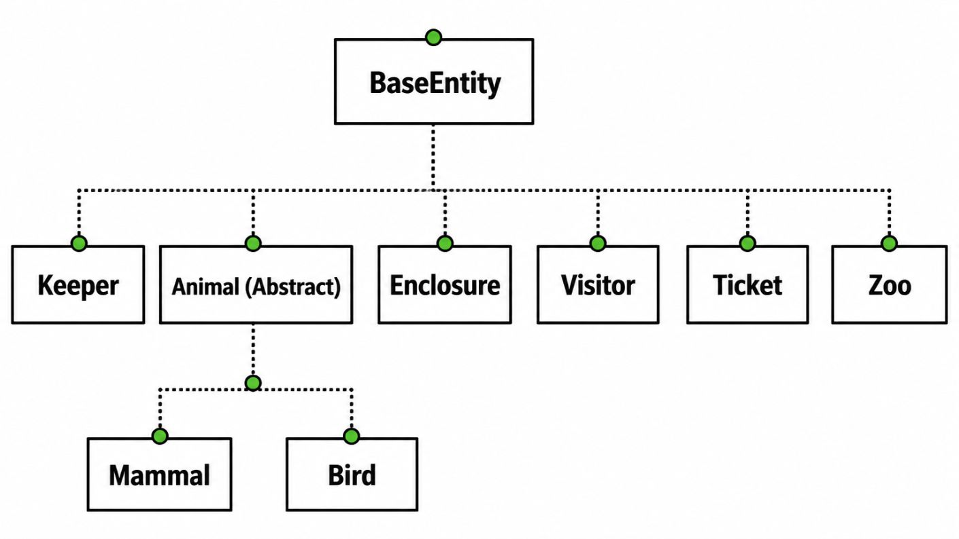

Domain Model
Class Hierarchy
Key Relationships
Animal inherits from BaseEntity
Mammal and Bird inherit from Animal
Keeper manages Animals
Enclosure houses Animals
Visitor purchases Tickets
The abstract Animal class enforces a consistent contract across all species types, enabling polymorphic behavior throughout the system.

Slide 5
Object-Oriented Programming Concepts
Core OOP Principles Implemented
Abstraction
Inheritance
Animal is an abstract base class — defines contract without exposing implementation details
Mammal and Bird inherit from Animal — reusing shared behavior and structure
Polymorphism
Encapsulation
CalculateFood() overridden in subclasses — each species computes dietary needs differently
Private fields with public properties — controlled access to internal state
Interfaces
Operator & Constructor Overloading
IFeedable, IHealthCheck — behavioral contracts decoupled from implementation
Custom operators for entities; multiple constructors per class for flexible instantiation
Method Overriding
Static Classes & Function Overloading
Subclasses override parent methods to provide species-specific behavior
Utility classes for shared calculations; multiple method signatures for flexible APIs

Slide 6
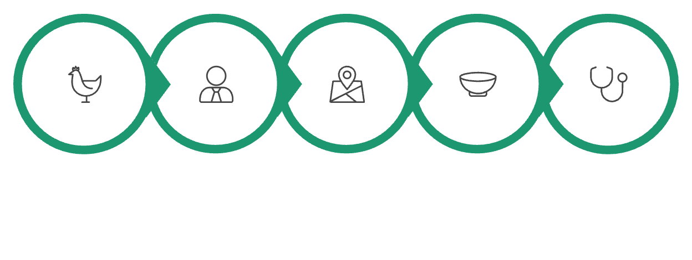
Business Logic Flow
Animal Management Workflow
Supporting Processes
Food Calculator
Automatic dietary calculations based on species, weight, and health status
Added
Assign Keeper
Assign Enclosure
Food Needs
Health Check
Each animal entering the system triggers a structured onboarding pipeline — from keeper assignment through enclosure allocation, dietary calculation, health verification, and final report generation.
Ticket Revenue
Visitor revenue tracking with automated financial summaries
Health Records
Complete medical history management per animal
Visitor Tracking
Attendance analytics and demographic data collection

Slide 7
Features
Complete System Capabilities
Animal Management
Keeper Management
Add, update, delete animals with full records
Assign and manage zoo staff
Visitor Management
Ticket Management
Track visitor information and demographics
Automated ticket generation and sales
Food Calculation
Automatic dietary requirement calculations
Health Monitoring
Enclosure Management
Track animal health and medical records
Manage habitats and capacity
Revenue Reports
MongoDB Storage
Generate financial and operational reports
Scalable NoSQL database persistence
REST API
Full API for system integration

Slide 8
Conclusion
Project Achievements
Clean Architecture
OOP Principles
Layered, maintainable design with clear separation of concerns across all system tiers
Full implementation of abstraction, inheritance, polymorphism, encapsulation, and more
Modern C# / .NET 10
MongoDB Integration
Leveraging the latest .NET 10 features for performance and developer productivity
Scalable NoSQL database implementation with full CRUD operations
REST API
Modular Design
Complete API endpoints enabling full system integration and extensibility
Decoupled, reusable components that can be independently maintained and extended
Scalable Architecture
Enterprise Ready
Enterprise-ready solution designed to grow with operational demands
Production-quality code adhering to industry best practices and standards

Slide 9
Thank You
Zoo Management System — Enterprise Solution Built with C# (.NET 10) & Clean Architecture
Team Infinity Loop
Technology Stack
Md. Ibrahim Khalil Tushar • Noor Hasnat • Limon
Department of Computer Science & Engineering
C# / .NET 10
ASP.NET CORE
MONGODB
REST API
CLEAN ARCHITECTURE

